Slide 1


Slide 2
THE HALL EFFECT
Definition
Background
Mathematical derivation
Explanation
Applications
Advantages
Disadvantages
Reference

Slide 3
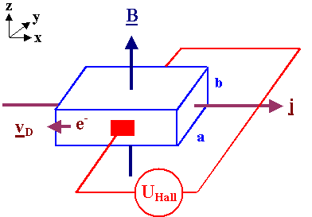

Definition :-
The production of a potential difference across a conductor carrying an electric current when a magnetic field is applied in a direction perpendicular to that of the current flow is termed as HALL EFFECT.

Slide 4
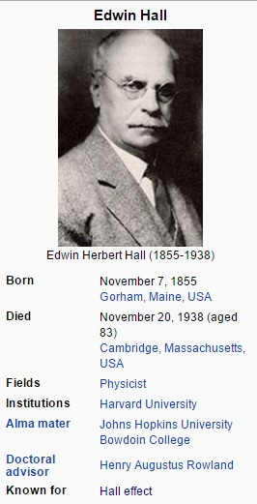
Background
The Hall effect was discovered by Hall in 1879, while working on his doctoral thesis in Physics. In 1880, Hall's experimentation was published as a doctoral thesis in the American Journal of Science and in the Philosophical Magazine.

Slide 5
Mathematical Proof :-
A movable charge in a condutor experienced two forces, an electrical force and magnetic force, combinaly called lorentz force. The resultant becomes zero by balancing each other.
F=qe + qv(B)
As F= 0 the above equation become
0=qe+qvd x B

Slide 6
0=q(E+vd x B)
0=E+Vd x B dividing dy q
E=-V x B
In term of magnitude
E=Vd x BsinØ where Ø = 90
E=VdB----------(1)
By relation of current density and drift velocity, J=nqvd

Slide 7
As
Vd= J/ne
Putting the value of Vd in equ(1)
E=(J/nq)B-------(2)
Relation of voltage and electric field
E= V/d (d=width of plate)
Putting value of E in equ(2)

Slide 8
now
V/d = (j/nq)B
nqV = djB----3
Current density is given by
J= I/A
If t is thickness and d is width of plate
J=I/dt------(4)
Putting 4 in 3
Nqv= d(I/dt)B
Vh= IB/nqt

Slide 9
Explanation:-
We have repeatedly stated that the mobile charges in conventional conducting materials are negatively charged (they are, in fact, electrons). Is there any direct experimental evidence that this is true? Actually, there is. We can use a phenomenon called the Hall effect to determine whether the mobile charges in a given conductor are positively or negatively charged. Let us investigate this effect………..???

Slide 10
Experimental Apparatus:-
Strong magnetic field.
Conducting plate (thin, flat and uniform surface).
Both must be perpendicular to each other.

Slide 11
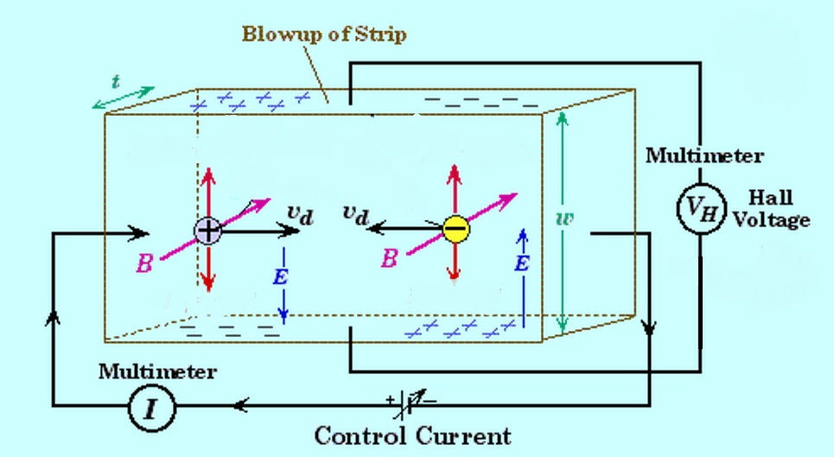
Possible ways of conduction
Conduction due to Positive charge
Conduction due to Negative charges

Slide 12
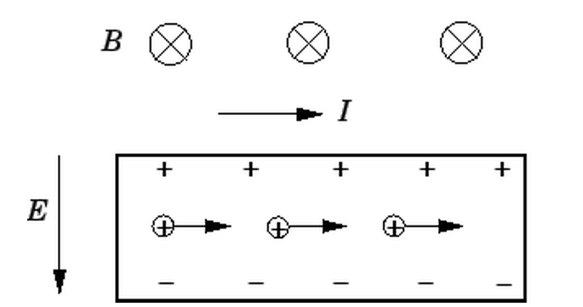
Mechanism:- 1)Suppose that the current is carried by positive charges moving from left to right. 2)These charges are deflected upward (in the figure) by the magnetic field. Thus, the upper edge of the plate becomes positively charged, so the lower edge becomes negatively charged.

Slide 13
3)When the majority of charge carriers are positive, they are deflected to the top of the plate so that the top of the plate attains a higher positive potential.
4)Consequently, there is a positive potential difference between the upper and lower edges of the plate. This potential difference is called the Hall voltage.

Slide 14
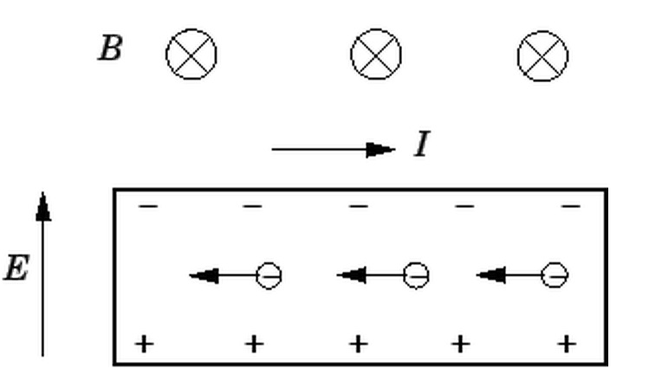
1)Suppose, now, that the current is carried by negative charges moving from right to left.
2)These charges are also deflected upward by the magnetic field.
3)Thus, the upper edge of the plate becomes negatively charged, so the lower edge becomes positively charged.

Slide 15
4)It follows that the Hall voltage (i.e., the potential difference between the upper and lower edges of the plate) is negative in this case. 5)If the majority of the charge carriers are negative then the top of the plate will become negative and the polarity of the Hall voltage will reverse.

Slide 16
RESULT OF EXPERIMENT
1)Clearly, it is possible to determine the sign of the mobile charges in a current carrying conductor by measuring the Hall voltage.
2)If the voltage is positive then the mobile charges are positive (assuming that the magnetic field and the current are orientated as shown in the figure), whereas if the voltage is negative then the mobile charges are negative.

Slide 17
3)If we were to perform this experiment we would discover that the the mobile charges in metals are always negative (because they are electrons).
4)However, in some types of semiconductors the mobile charges turn out to be positive.
5)These positive charge carriers are called holes.

Slide 18
Application
Hall effect devices produce a very low signal level and thus require amplification. In early 20th century vacuum tube amplifiers were expensive and unreliable. But with the development of the low cost integrated circuit the Hall effect sensor became suitable for mass application.

Slide 19
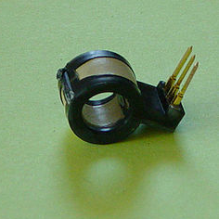
Current Sensor
When electrons flow through a conductor, a magnetic field is produced.
Thus, it is possible to create a non-contacting current sensor. This has several advantages:
No additional resistance (a shunt) need be inserted in the primary circuit.
Also, the voltage present on the line to be sensed is not transmitted to the sensor, which enhances the safety of measuring equipment.

Slide 20
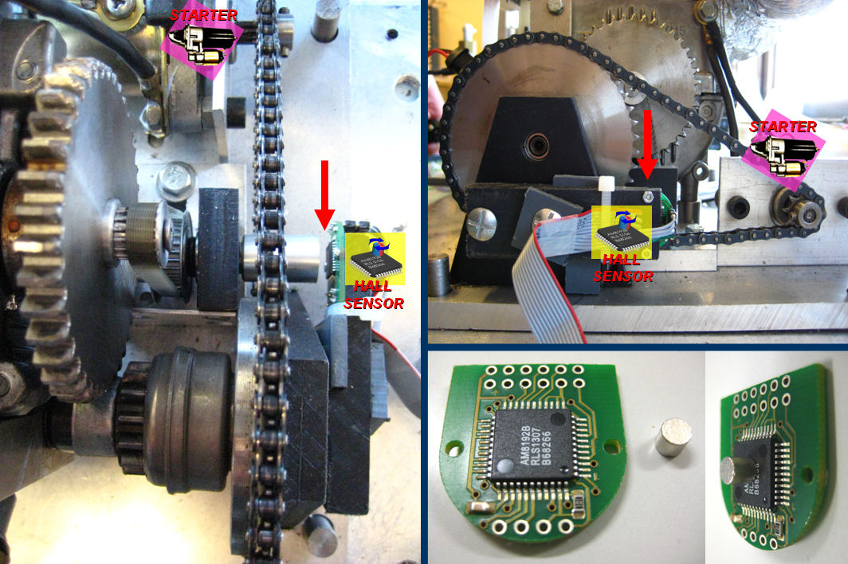
Electric Motor Control
Some types of brushless DC electric motors use Hall effect sensors to detect the position of the rotor and feed that information to the motor controller. This allows for more precise motor control.

Slide 21
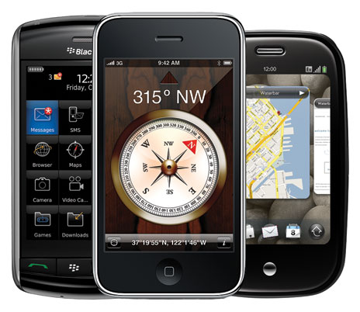
MAGNETOMETER
Smart phones like iPhone 3GS are equipped with magnetic compass.
These compass measure Earth‘s magnetic field using magnetometer.
These magnetometer are sensors based on Hall Effect.
These sensors produce a voltage proportional to the applied magnetic field and also sense polarity.

Slide 22
Disadvantages compared with other methods
Magnetic flux from the surroundings (such as other wires) may diminish or enhance the field the Hall probe intends to detect, rendering the results inaccurate. Also, as Hall voltage is often on the order of millivolts, the output from this type of sensor cannot be used to directly drive actuators but instead must be amplified by a transistor-based circuit.

Slide 23
References
Wikipedia
Ilmi guid for physics
www.iop.com
Physicsforum.com
Physics by E.D Hall

